Slide 1
Divvy Bike Share Analysis
Presented by: Stephanie Goodman
Last updated: July 24th, 2023

Slide 2
Table of Contents
Statement of Purpose
Specific Metrics through Data Story Telling
Conclusion and Action Steps
Appendix
Documentation

Slide 3
Objective
Analyze historical bike data in order to determine usage patterns by rider type, casual and annual.
Notes:
This analysis will give us a more holistic understanding of how riders use the bike share service, so that we can better encourage casual riders to purchase annual memberships.
For this analysis we looked at bike share rider data from May 2022-May 2023, so that we can use the most recent and accurate data possible.

Slide 4
What data are we measuring?
This data comes from a 12-month analysis of bike user data, which includes information on specific rides, bike users, and locations of rides.
Tools used: Excel spreadsheets, SQL, and R.
”Accidental” rides were omitted from the data
Limitations of the data include:
No information regarding user id or customer id, meaning that it is unclear how many rides are from the same user vs unique users
Limited geographical data
Data spans a 12-month period, longer-term insights require additional data
Notes:
Accidental rides are rides that were less than one second in duration, or more than 24 hours in duration. This is because that it’s likely that both bike durations were accidentally implemented (ex: user forgetting to end their ride at the correct time).

Slide 5

Members tend to take more Divvy Rides
There isn’t much of a difference in member vs casual rides, from an annual level.
This difference becomes more pronounced in the winter months, with more member rides.
As the warmer months begin, the percentage of casual riders begins to increase.

Slide 6
The percentage of annual members has risen, even in warmer months
Notes:
When comparing May 2022 and May 2023, we see a small uptick in member usage vs casual usage. Over time we can continue to monitor this and see if this trend will continue.

Slide 7
Casual Members Tend to Take Longer Daily Trips
The average trip for a casual member from May 2022-May 2023 was 25 minutes.
On average, annual member’s trips during the same timeframe was much shorter, at 8 minutes.
Notes:
Here ride length is measured in minutes, and the average ride length for a casual rider is over double that of an annual member. This could be due to a variety of factors that we could use further data collection to confirm. It could be that annual users are taking more trips and use their bikes for small errands instead of just bigger rides.

Slide 8
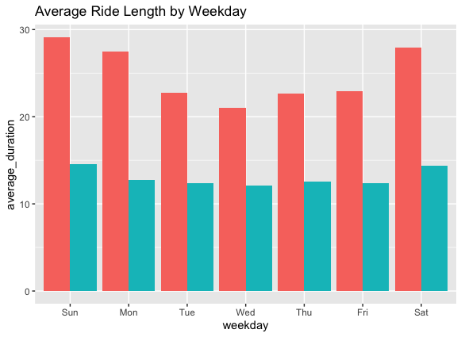
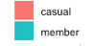
Ride length varies by day of week
Days for longest ride length are Saturday and Sunday.
Shortest rides are on Wednesdays.
Casual riders had higher ride lengths than members regardless of weekday.
Notes:
Although casual bike users tended to take significantly longer trips than annual members, both bike users demonstrated similar trends in weekly usage. From an annual perspective, bike rides tended to be the longest on Saturdays and Sundays, gradually decreasing until the lowest day of usage, Wednesdays. Thursdays and Fridays show gradually increased ride length until the peak weekend times.

Slide 9
Fewer bike rides are taken in the cooler months
The number of bike trips taken decreases significantly in the cooler months.
The number of bike trips peaks in the warmest months, such as July.

Slide 10
Annual members take more trips overall
Regardless of month, annual members took more bike trips than casual members.
Notes:
While casual riders take longer rides, annual members tend to take more rides, especially on weekdays.
Casual usership really drops off in winter months, like December.

Slide 11
Conclusions
Casual users tend to use Divvy bikes for longer rides during weekend trips, especially in the warmer months.
Annual members tend to use Divvy bikes for shorter rides, but take more rides throughout the week, and ride length holds steady throughout the week.
Casual users tend to use Divvy bikes for longer stretches, but most bike rides logged overall are from annual members.
Most Divvy bike users are annual members. The difference in percentages is largest during winter months, and the gap is smallest during summer months.
Notes:
The number of rides and and ride length increase

Slide 12
Action Steps
Offer incentives to casual users to convert to annual members in the warmer months while usage is high.
Begin to advertise exclusive promotions/benefits for annual members during high usage periods, which includes weekends and holidays.
Offer “weekday” or “commute” discounts to promote weekday and off-season bike usage.
Use creative strategies to reward longer bike trips for annual users, such as weekly/quarterly/annual usage reports.
Send out a user survey to annual members inquiring about what led them to convert from casual to member status.
Notes:
Marketing can capitalize on the surge of casual users in the warmer months by increasing incentives and advertising geared towards casual members in order to convert them to annual members.
Weekly/quarterly/annual usage reports: think Spotify wrapped but for bike usage. Provide easy ways to share bike usage on media, focusing on health, economical, and environmental benefits (ex: This year, you saved an average of ____ gallons of gas by choosing Divvy bikes).
User survey will allow us to gain further insights into what incentives were and weren’t effective in promoting annual membership, which will allow us to maximize our marketing efforts.

Slide 13
Appendix
Data used for this analysis was made available by Motivate International Inc, under this license agreement.
Analysis was done using a combination of Microsoft Excel, Posgre SQL (accessed through Dbeaver), and RStudio.
All visualizations were created using Microsoft Excel and Rstudio.

Slide 14
Documentation
If you are on this slide, thank you for taking the time to go through this sample presentation on bike share data!
This slide would most likely not be included in a shareholder presentation unless directly requested, as it provides a link to the analysis steps I took throughout the process of completing this project.
For this project I used Microsoft Excel, SQL, and RStudio. The following slides will include the following as documentation of my analysis process:
Screenshots of data validation, data cleaning, and basic analysis performed in Microsoft Excel using data from individual months.
Sample SQL query and result
Sample code run in RStudio with results

Slide 15
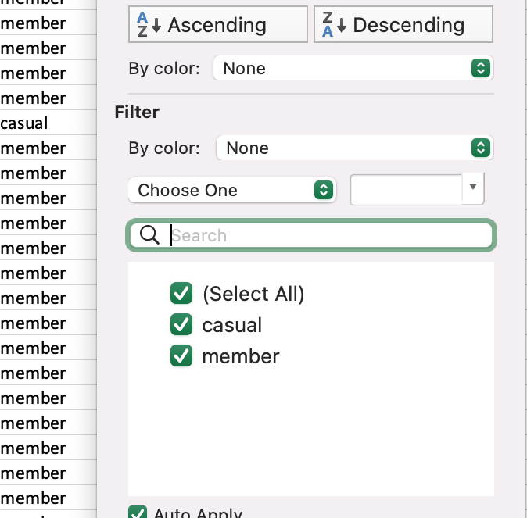
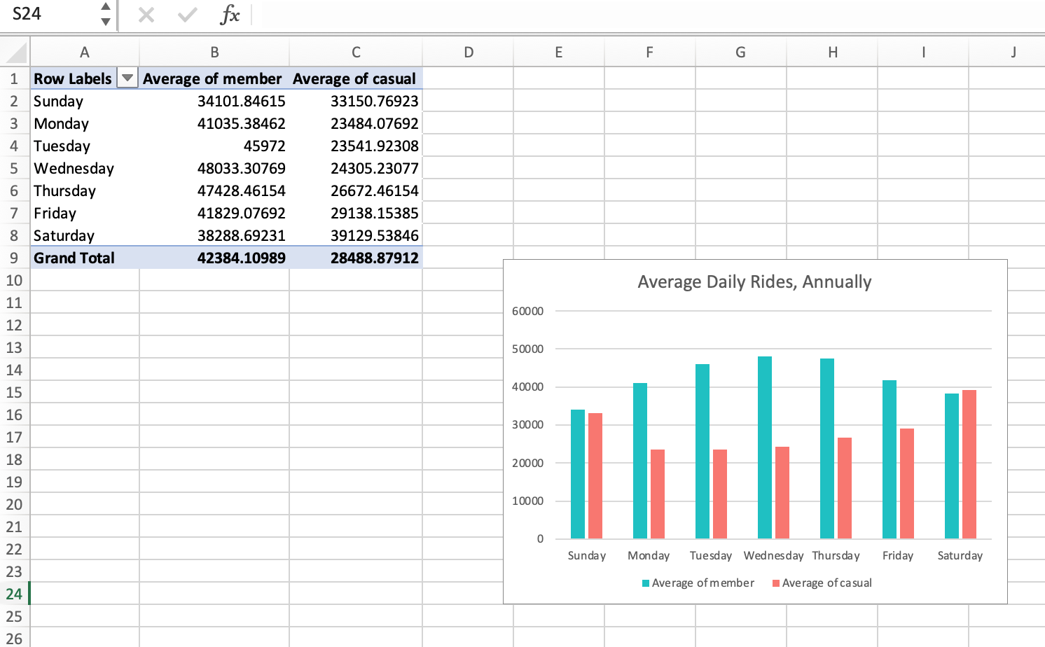
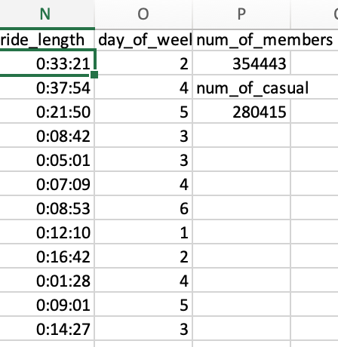
Documentation: Excel
Pivot tables, formulas, and filters were primarily used in Excel, in order to clean copies of the data both to:
Ensure data integrity before inputting into SQL and RStudio for aggregation and visualization on a larger scale.
Gain more specialized insights on specific months and seasons to compare to annual data.
Notes:
Includes samples of the filtering process, new columns added (functions and formulas used included: MODE(), AVERAGE(), WEEKDAY(), COUNTIFS()), and pivot table(s).

Slide 16
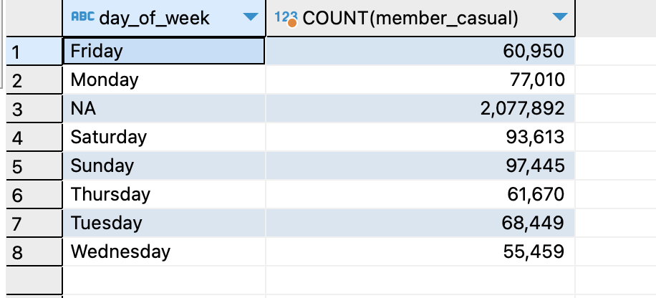
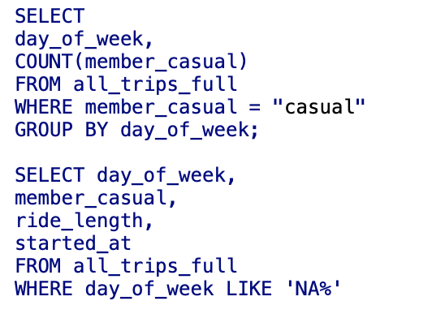
Documentation: SQL
Mainly used the all_trips_full.csv file created in Rstudio for specific queries that referenced all 12 months of data rather than individual spreadsheets.
SQL was used rather than Excel due to the high volume of data created when each spreadsheet was combined into a much larger dataset.
SQL was used alongside R for specific functions that allow for quick and accurate insights that are more time consuming to achieve in R.
Viewing the number of “NA” under the “day_of_week” column warranted further use of Excel and Rstudio in order to ensure accurate results.
Notes:
Mainly providing examples of WHERE filter statements that allowed for insights on all_trips_full.csv

Slide 17
Documentation: RStudio, Part 1
RStudio was used in order to clean, filter, aggregate, and visualize the entirety of the historical data in order to gain larger-scale insights.
RStudio was used rather than Microsoft Excel for these steps due to the sheer quantity of the data.
RStudio was used rather than SQL for these steps due to the visualization capabilities in R.
Given the sheer quantity of the data and the need for clear high-level visualizations, using a programming language was one of the options for best practice for this case study. An alternative option would be to use SQL to sort, filter, clean, and aggregate the data, then compile the data into Tableau to either create a static visual or an interactive dashboard, depending on the needs of the stakeholders.
A sample Tableau dashboard is included on my portfolio here.
Depending on the needs of the stakeholders and the analytical team, an R Markdown file may be created to share, either as a report or as a collaborative document to use with other analysts
A sample R Markdown document is also included on my portfolio here.

Slide 18
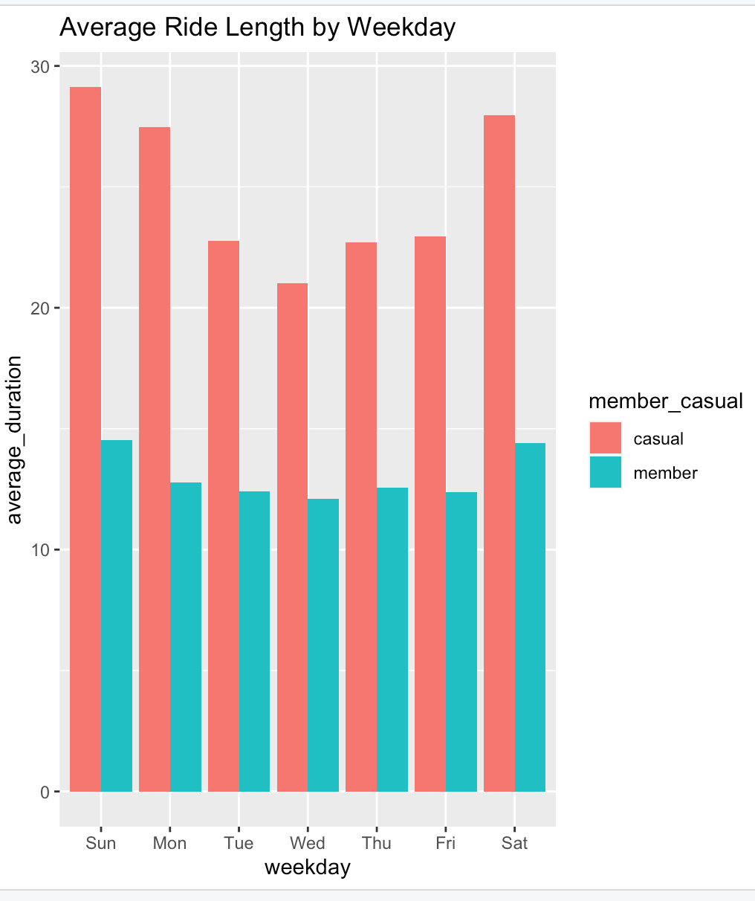
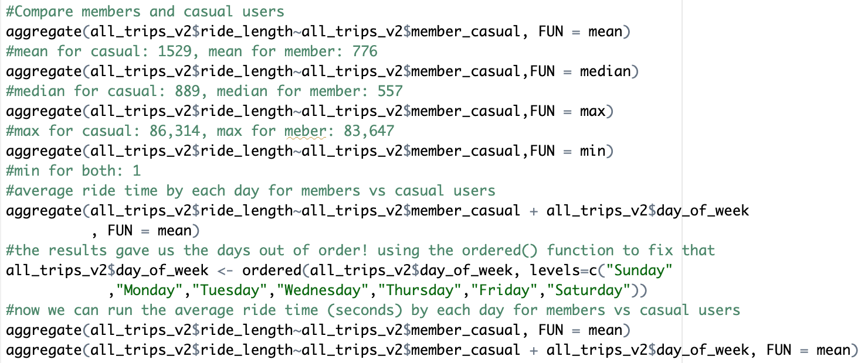
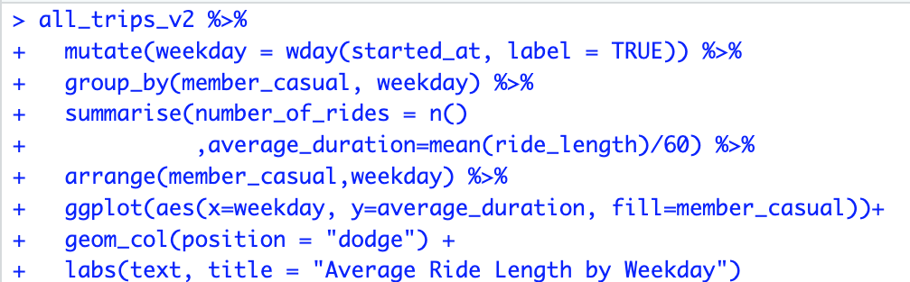
Documentation: RStudio, Part 2

Slide 19
Thank you!
Notes:
Thank you for coming to this presentation of Divvy bikeshare data! I hope you learned some insights and enjoyed learning about this dataset as much as I did. Let me know if you have any questions, either via email or through LinkedIn.

